Slide 1

Club Assist Meeting Agenda
Sebang Global Battery Co., LTD
Overseas Business Div.
DATE | 2015. 4. 23
Attendee | America-Oceania Team
This document, including any attachments, contains confidential information. It may be read, copied and used only by the intended person.
Any use by a person other than its intended person, or by the person but for the purposes other than the intended purpose, is strictly prohibited.

Slide 2
Context
Australia and New Zealand Business
a) Purchasing volume review
b) Opportunities of supplying new items to CA
c) Moving delivery terms to FOB
d) GRI issue for Australia
e) Change OA credit terms to 90days
f) 3554 & 6558 top label attached location
g) 2138 left hand positive configuration issue
h) August delivery shipment delay
i) Contract extension
j) Board of directors, management
2. North America Business
a) Purchasing volume review
b) Northern California, Florida & Canada quotation
c) Qutation of other low volume NA sku’s
d) Type 47 battery
e) Warranties
f) Battery US samples
This information is confidential and was prepared by SBC AO(America Oceania) Team. It is not to be relied on by any 3rd party without SBC AO Team’s
prior written consent.

Slide 3
1. Australia and New Zealand Business
a) Purchase Volume Review
▷ Purchasing Volume (2012 ~ 2014) / Based on Shipment
Club Assist | 2012 |  | 2013 |  | 2014
 | Q’ty | Amount(USD) | Q’ty | Amount(USD) | Q’ty | Amount(USD)
Automotive | 11,820 | 470,289.68 | 157,840 | 6,690,970.58 | 190,604 | 8,168,839.73
AGM | 0 | 0 | 0 | 0 | 219 | 27,286.20
TOTAL | 11,820 | 470,289.68 | 157,840 | 6,690,970.58 | 190,823 | 8,196,125.93
▷ Year-to-year purchasing volume fluctuation (January ~ April)
This information is confidential and was prepared by SBC AO(America Oceania) Team. It is not to be relied on by any 3rd party without SBC AO Team’s
prior written consent.
1 / 12

Slide 4
1. Australia and New Zealand Business
b) Opportunities of supplying new items to CA
▷ Currently supplied items to Club Assist Australia
CA Battery # | Global Batteries # | Status
2543 | GB 25-13 | PASSED ALL VALIDATION PROCESS
2544 | GB 35-13 | PASSED ALL VALIDATION PROCESS
4703 | GB 900R-18 | PASSED ALL VALIDATION PROCESS
4704 | GB 900L-18 | PASSED ALL VALIDATION PROCESS
2508/5043 | GB 50D20L-10(BH) | PASSED ALL VALIDATION PROCESS
3554/6558 | GB 56219P-13(BHAD)(PIN) | PASSED ALL VALIDATION PROCESS
3664/6668 | GB 57820P-15(BHAD)(PIN) | PASSED ALL VALIDATION PROCESS
5536 | AGM70L3 | PASSED ALL VALIDATION PROCESS
3888 | AGM92L5 | PASSED ALL VALIDATION PROCESS
2138 | GB 450L | PASSED ALL VALIDATION PROCESS
2136 | GB 450RS | PASSED ALL VALIDATION PROCESS
2135 | GB 450RS | PASSED ALL VALIDATION PROCESS
▷ New items Global wish to supply
CA Battery # | Global Batteries # | Status
2503 | GB AU22R-72 | Top width & Dual Fit Termianal dimension unacceptable to CA requirements
2542 | GB 22F-78DF
This information is confidential and was prepared by SBC AO(America Oceania) Team. It is not to be relied on by any 3rd party without SBC AO Team’s
prior written consent.
2/ 12

Slide 5
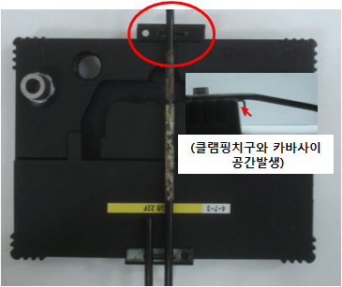
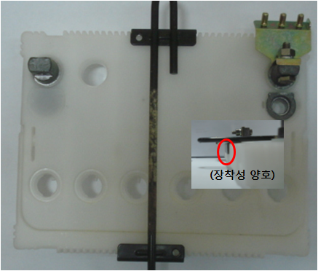
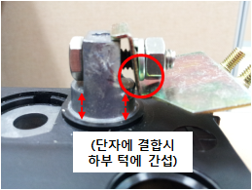
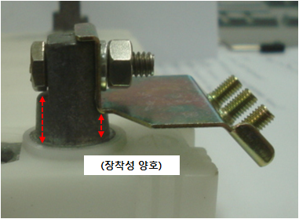
4. New Items for Australia (AU22 & 22F)
4. New Items for Australia (22F, AU22)
1. Australia and New Zealand Business
Comparison Between Global product and Club Assist product
Type | Comparison between Global product and CA product |  | Remarks
 | Global Product | Club Assist
Cover (Width) |  |  | Global products width is 5mm smaller than the battery clamp width Global Width : 168mm CA Width : 173(+2.0)
Terminal Shape |  |  | - Global’s product has flat terminal which interfere terminal clamping
Global is willing to change the design of AU22 & 22F to CA requirements. (Total Cost of Development $191,200)
Annual Volume per each type of 22F
CCA | RC | Annual Volume
450 | 75 | 40,000
500 | 85 | 50,000
550 | 95 | 75,000
610 | 90 | 4,000
Total |  | 169,000
Global Would like to receive target price per each type of 22F
This information is confidential and was prepared by SBC AO(America Oceania) Team. It is not to be relied on by any 3rd party without SBC AO Team’s
prior written consent.
3 / 12

Slide 6
1. Australia and New Zealand Business
c) Changing incoterms to FOB
▷ CIF Ocean Freight to Australia and New Zealand Ports
PORT | OCEAN FREIGHT(US$) | REMARKS
Brisbane | $1,200/teu
Sydney | $1,200/teu
Melbourne | $1,200/teu
Fremantle | $1,200/teu
Adelaide | $1,200/teu
Townsville | $2,600/teu
Auckland | $1,200/teu | Not shipped yet
Extended
(+) Grid
Global agrees changing incoterms from CIF to FOB.
When incoterms are changed to FOB, Global will contact Club Assist’s nominated freight forwarder to arrange shipment after production.
This information is confidential and was prepared by SBC AO(America Oceania) Team. It is not to be relied on by any 3rd party without SBC AO Team’s
prior written consent.
4 / 12

Slide 7
1. Australia and New Zealand Business
d) GRI issue for Australia
Additional ocean freight of USD$500 was applied to November, December and January orders.
Destination | Quantity(CNTR) | Amount(USD)
Brisbane | 19 | $9,500
Sydney | 30 | $15,000
Melbourne | 19 | $9,500
Adelaide | 1 | $500
Total | 69 | $34,500
Townsville order has been not counted as the actual ocean freight exceeds $1,700 per 20ft CNTR.
Club Assist and Global agreed to offset overpaid amount ($34,500) by applying FOB prices to March and April orders.
Total $25,277.48 has been offset from March placed orders. Remaining $9,222.52 will be offset from April placed orders.
Details has been sent to Mr. Dojo Esquivel
This information is confidential and was prepared by SBC AO(America Oceania) Team. It is not to be relied on by any 3rd party without SBC AO Team’s
prior written consent.
5 / 12

Slide 8
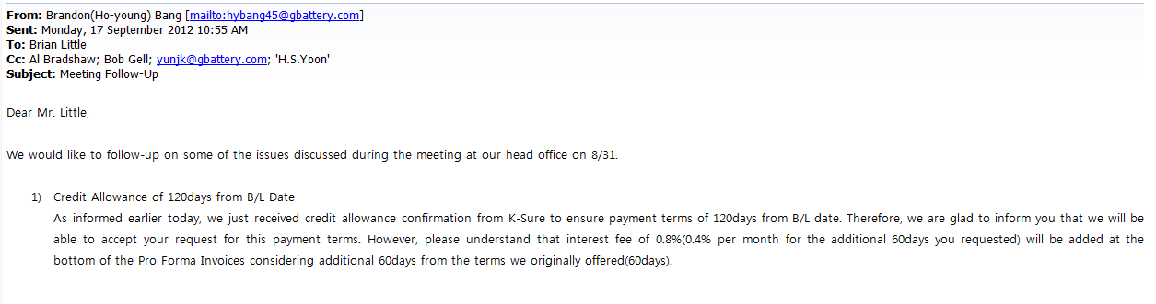
1. Australia and New Zealand Business
e) Change OA credit terms to 90days
Global has been applying additional 0.8% to the invoice amount as 120days usance.
This cost is for the additional 60days credit that we give to Club Assist.
If Club Assist wants to change OA credit terms to 90days then Global would have to apply
additional 0.4% to the invoice amount.
Global can give only 60days credit at no additional invoiced amount.
This information is confidential and was prepared by SBC AO(America Oceania) Team. It is not to be relied on by any 3rd party without SBC AO Team’s
prior written consent.
6 / 12

Slide 9
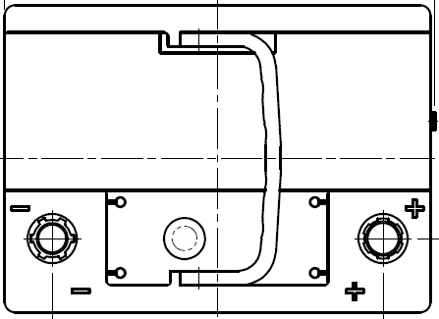
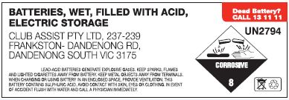
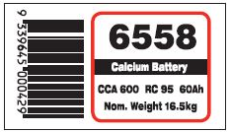
1. Australia and New Zealand Business
f) 3554 & 6668 top label attached location
Current label attached location for 3554 & 6668 (High CCA DIN)
Due to the cover design change of 3554 & 6668 the label attached location has been changed as above.
We have received confirmation mail that the labels are good to go from Tim Lennon.
This information is confidential and was prepared by SBC AO(America Oceania) Team. It is not to be relied on by any 3rd party without SBC AO Team’s
prior written consent.
7 / 12

Slide 10
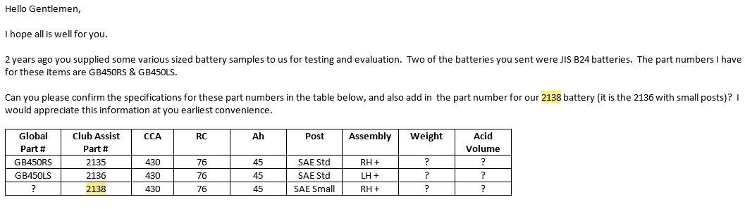
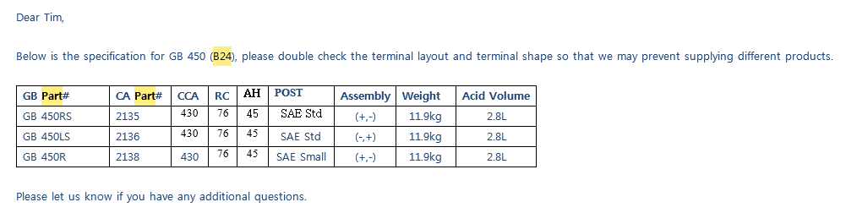
1. Australia and New Zealand Business
g) 2138 left hand positive configuration issue
Item 2138 was first ordered on September, 2014
Before 2138 being ordered, there was mis-communication between CA and Global about battery specification
▷ Received Mail from CA
▷ Return Mail from Global
This information is confidential and was prepared by SBC AO(America Oceania) Team. It is not to be relied on by any 3rd party without SBC AO Team’s
prior written consent.
8 / 12

Slide 11
1. Australia and New Zealand Business
▷ 2138 (GB 450R) with left hand positive configuration shipped quantity
PO No. | Port | Quantity | Remarks
PO0013049 | Melbourne | 72 | Shipped
PO0013048 | Sydney | 360 | Shipped
PO0013284 | Melbourne | 144 | Shipped
PO0013286 | Sydney | 504 | Returned from CY, Replaced correct item
Total 576pcs of LH+ 2138 has been shipped to Melbourne and Sydney
CA notified to Global that they will take care of 576pcs that has been already shipped to Australia
as there was mis-communication on both sides
This information is confidential and was prepared by SBC AO(America Oceania) Team. It is not to be relied on by any 3rd party without SBC AO Team’s
prior written consent.
9 / 12

Slide 12
1. Australia and New Zealand Business
h) August delivery shipment delay
▷ Shipment Delay & Low OCV Claim
In July, due to hot weather OCV for Club Assist May placed orders went down to 12.67 ~ 12.72V
Global provided two options to Club Assist.
1) Recharge the batteries (Notified Club Assist that shipment will be delayed around 20 days)
2) Ship the batteries without recharge (Global to pay the recharge cost to Club Assist)
Club Assist agreed Global to recharge the batteries.
Global partially shipped items that OCVs are above the shipment basis. (Above 12.79V)
Club Assist May placed orders arrived between 10th August ~ 22nd August.
Due to shipment delays, Club Assist needed to relocate the stocks. Club Assist advised that this will incur in excess of $20,000AUD freight costs.
1st shipment of August arrival orders arrived to Queensland warehouse. Received a report from Club Assist that most of these new stocks needs to be rechared. (Total 2,268pcs / below 12.60V). Also mentioned that $1,732.50AUD cost incurred for recharge.
Janaury, 2015 Club Assist notified to Global that their final claim for this issue is $13,579.88
Discuss Compensation Plan
This information is confidential and was prepared by SBC AO(America Oceania) Team. It is not to be relied on by any 3rd party without SBC AO Team’s
prior written consent.
11 / 12

Slide 13
1. Australia and New Zealand Business
i) Contract extension
Supply Agreement between Sebang Global Battery and Club Assist will expire on 30th June, 2015
Between this period Club Assist agreed to order from Global the following Batteries per year:
(a) Minimum 140,000 Batteries
(b) Maximum 240,000 Batteries
By suppling Group B24 and High CCA DIN, 22 series, Global will be able to supply more than the maximum
volume above
-> Annual purchasing volume B24 80,000pcs + High CCA DIN 40,000pcs + α (22 series)
Considering B24, High CCA DIN and 22 series, Global would like to extend the minimum and maximum order
volume on the new supply contract as below:
(a) Minimum 320,000 Batteries
(b) Maximum 420,000 Batteries
Extended
(+) Grid
Any other subjects that Club Assist would like to discuss about the contract?
This information is confidential and was prepared by SBC AO(America Oceania) Team. It is not to be relied on by any 3rd party without SBC AO Team’s
prior written consent.
12 / 12

Slide 14
1. Australia and New Zealand Business
j) Board of Directors, management
Extended
(+) Grid
This information is confidential and was prepared by SBC AO(America Oceania) Team. It is not to be relied on by any 3rd party without SBC AO Team’s
prior written consent.
12 / 12

Slide 15
Thank you ☺
This information is confidential and was prepared by SBC AO(America Oceania) Team. It is not to be relied on by any 3rd party without SBC AO Team’s
prior written consent.

Slide 16
1. North America Business
a) Purchase Volume Review
▷ Purchasing Volume (2012 ~ 2014) / Based on Shipment
Club Assist | 2014 |  | 2015 (JAN~MAR)
 | Q’ty | Amount(USD) | Q’ty | Amount(USD)
Automotive | 49,701 | 2,073,238.39 | 23,232 | 886,195.51
b) Northern California, Florida & Canada quotation
c) Quotation of other low volume NA sku’s
d) Type 47 battery
Same as Australia supplied high CCA DIN 3554/6558
CA# | Global# | CCA | RC | Ah
3554/6558 | GB 56219P-13-IDX | 600 | 95 | 60
e) Warranties
This information is confidential and was prepared by SBC AO(America Oceania) Team. It is not to be relied on by any 3rd party without SBC AO Team’s
prior written consent.
1 / 2

Slide 17
2. North America Business
f) Battery US samples
TYPE | Spec. |  | Status
 | CCA | RC
26R-KC | 560 | 86 | HOLD
27F-KC | 710 | 125 | SENT
48-KC | 760 | 135 | SENT
51R-KC | 450 | 76 | SENT
58-KC | 540 | 86 | SENT
75-KC | 660 | 100 | HOLD
86-KC | 710 | 110 | HOLD
94R-KC | 780 | 160 | SENT
Extended
(+) Grid
Five part numbers were sent to Melbourne on 4/23 (PO0014149 / 20121643)
Remaining three part numbers need internal validation before being sent
This information is confidential and was prepared by SBC AO(America Oceania) Team. It is not to be relied on by any 3rd party without SBC AO Team’s
prior written consent.
2 / 2

Slide 18
Thank you ☺
This information is confidential and was prepared by SBC AO(America Oceania) Team. It is not to be relied on by any 3rd party without SBC AO Team’s
prior written consent.

